Slide 1




Gamification for reduced energy consumption
Leverage energy data for Luxembourg with
ZeroKnowledge

Slide 2












Understanding the problem The potential of energy data is barely scratched
Gamification
Smart Meter roll-out
Energy data available to use
Reduced consuption
Increased efficiency
Data privacy
Data interoperability

Slide 3
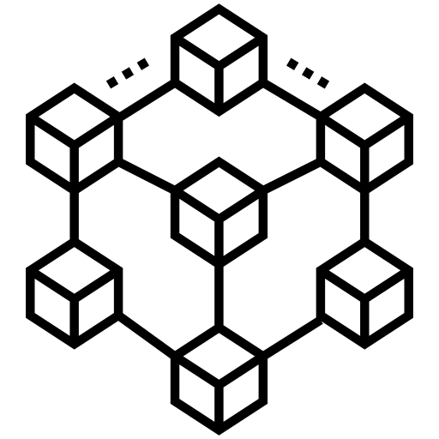
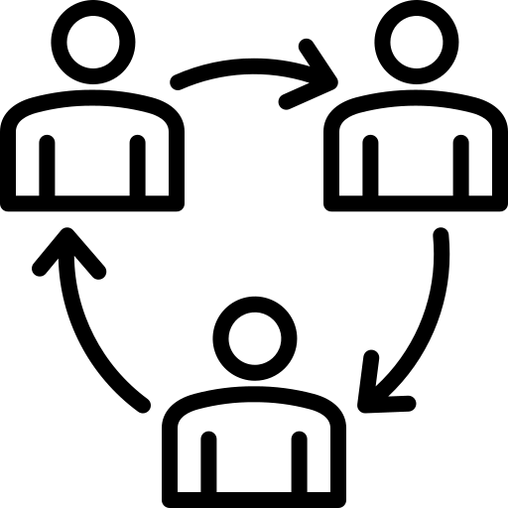



Designing the solution Secure data infrastructure and economic incentives
Secure multi-party computation
Zero-knowledge proofs
Blockchain
Token reward $→\text{Reduced} \text{consumption}$
Incentivize via gamification

Slide 4


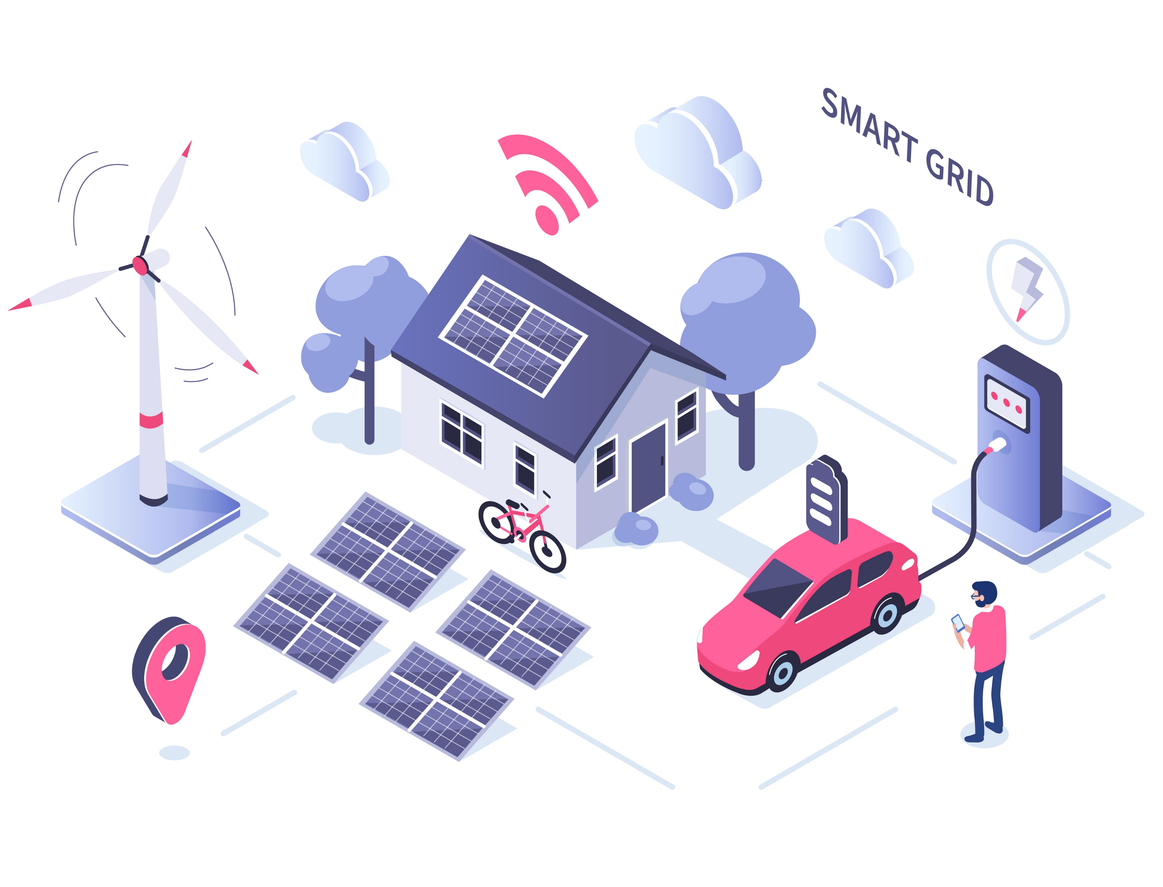


Powering the public sector Potential of open data for increased energy efficiency
Benefits
Area of application
Secure & Open Data
?
Easy to use
Modular & Scalable

Slide 5

Technical implementation Our proof of Concept
Stage 0 Set up game
END Game
Stage 4 (Player A)
Commit result
Send proof_4
Stage 1 (Player A) Commit data_1
Send proof_1
MPC +
ZKP
MPC: Multi-party computation
Privacy for many parties, no integrity
ZKP: Zero-knowledge proof
Integrity and privacy for one party
Stage 3 (Player C) Commit data_3 Send proof_3
Stage 2 (Player B) Commit data_2
Send proof_2

Slide 6

Leverage energy data for Luxembourg with ZeroKnowledge! Enabling and motivating individuals to securely share data and save energy

Slide 7
Smart Meter (A)
Blockchain
{ id: [id_A],
consumption: a,
timestamp: [unix],
{pKey_A, sKey_A} }
com(r), com(a+r),pKey_A
a, r,
pKey_A
ZKP generator
verifyZKPs
Pi_1
Communicate via PKI
Agent (A)
MetaMask
stake_A, pKey
{ pKey,
sKey
}
competition
mpc
Smart Meter (B)
{ id: [id_B], consumption: b,
timestamp: [unix] ,
{pKey_B, sKey_B} }
b, s, pKey_B
ZKP generator
com(a+r+b), pKey_B
verifyZKPs
Pi_2
Agent (B)
MetaMask
stake_B, pKey
{ pKey,
sKey
}
Rand r/s/com(…) are computed locally

Slide 8
P := {pKey_i |i=1,… ,n}
competition
S := {stake_i |i=1,… ,n}
verifyStake
push key_i if valid >> P := {pKey_j |j=1,… ,m}
generateRandFactor(lastBlockhash, …)
>> R formGroups(P, R)
>> G := [A,B,C, A‘, B‘, C‘, …]
Comput rewards
>> distribute rewards
burn stakes
Check whether i has put a stake
verifyZKPs
e.g. Pi_1(A) proves validity of com(r) and
com(a+r)
If(m%3 != 0) { mint 1-2 token (i.e. pay back to agent m, m+1)
}
Check whether Pi_k(j) is valid
mpc(G)
Execute protocol (ca. every week, duration 4 d)

Slide 9
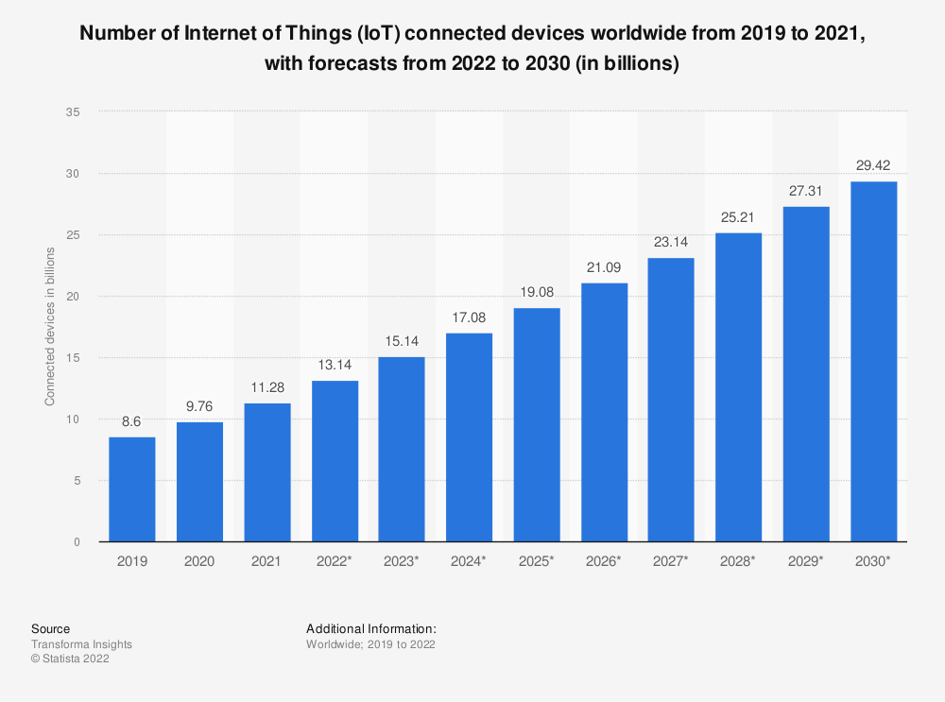

Slide 10
Sources Game theoretical approaches to energy reduction
Johnson et al. (2017): Johnson, D., Horton, E., Mulcahy, R., & Foth, M. (2017). Gamification and serious games within the domain of domestic energy consumption: A systematic review. Renewable and Sustainable Energy Reviews, 73, 249–264. doi:10.1016/j.rser.2017.01.134
AlSkaif et al. (2018): AlSkaif, T., Lampropoulos, I., van den Broek, M., & van Sark, W. (2018). Gamification-based framework for engagement of residential customers in energy applications. Energy Research & Social Science, 44, 187–195. doi:10.1016/j.erss.2018.04.043
Morganti et al. (2017): Morganti, L., Pallavicini, F., Cadel, E., Candelieri, A., Archetti, F., & Mantovani, F. (2017). Gaming for Earth: Serious games and gamification to engage consumers in pro-environmental behaviours for energy efficiency. Energy Research & Social Science, 29, 95–102. doi:10.1016/j.erss.2017.05.001
Games Help Save Energy - Scientific American
Power games encourage competitive energy-saving | Research and Innovation (europa.eu)
The power of training and gamification: How to influence energy use behaviour | News | CORDIS | European Commission (europa.eu)
GUIDELINE_GAMIFICATION_-_MAKING_ENERGY_FUN.pdf (smartgrid-engagement-toolkit.eu)

